Slide 1


AIBridge
Lecture 5
Notes:
Good afternoon everyone and welcome, my name is Phi and today I’ll be going over lecture #7

Slide 2
During training
Quality
Which one is a better line?
Acidity
Notes:
Let’s go back to the wine dataset. Here, the x-axis represents the acidity of the wine, and the y-axis represents the quality. You can kind of see a pattern already and that pattern probably looks something like this (click).
This line looks pretty decent, but what’s stopping us from drawing a line that looks like this? (click) (pause).
So think for a moment (click), which of the two lines better represents these datapoints?
Lets define what “better” means

Slide 3
Training vs. testing
Quality
Acidity
Let’s look at an unseen datapoint
Notes:
Let’s focus on the green line. Let’s say a model approximated the relationship between acidity and quality to be this line. Although the line doesn’t pass through each datapoint perfectly, this line has more predictive power (click).
What does that mean? (click)
Here, we have a new data point. Let’s say this was another datapoint in the original dataset that was never shown to the model. When we compare the model’s prediction to the actual (click), we see that the error is very small.

Slide 4
overfitting
Quality
Acidity
this model is highly accurate on training data
but bad at predictions at unseen testing data
Notes:
Now, for the red line. Let’s assume, the model fits the dataset to this long, winding line. This model looks like it would do amazing, all of the datapoints are close to or maybe even on the line. So, we can say with confidence that this model is more accurate on the training data… but ONLY on the training data (click).
Let’s bring back our test data point. (click)
You can probably see the issue already, the error is significantly higher for this point (click) (click).
So, this means that although this model performs excellently on its training dataset, when we want to use it to predict anything other than the training set, it does poorly.

Slide 5

overfitting
Quality
overfit!
Acidity
too-precise fits to original data without generalization is called overfitting
Notes:
There’s a term for what happened to the red line and it’s called overfitting, which means the model fits to the original data TOO precisely and doesn’t generalize to the underlying patterns.
You can think of it like a student who memorizes all the answers to a test. Although they can pass it with near perfect accuracy, they do really badly on anything other than questions on that test specifically.
TAKE QUESTIONS

Slide 6
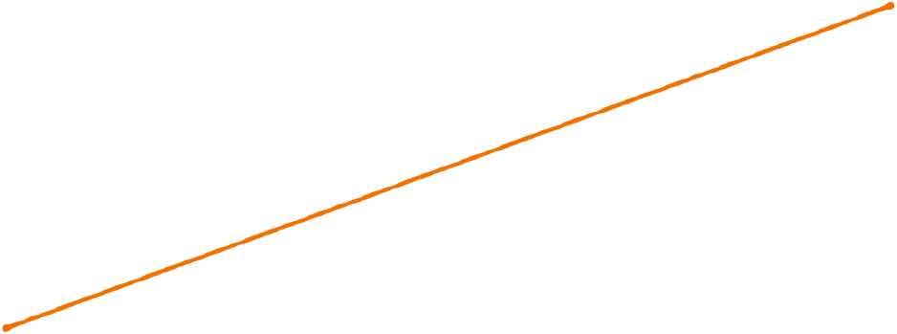

underfitting
degree 1
underfit!
model is unable to capture relationship between variables
Notes:
Let’s continue our discussion by looking at a new scenario. Here are some new data points. Let’s fit a model to it. (click)
Usually, when we fit a model to a set of points, we can control the complexity of the line, which basically means how much it curves. This is through a number called the degree. (click) - the degree is a hyper parameter that you can change as you train the model
This first line is probably what a model with a low degree—maybe a degree of one—would look like, and you can see that it’s not great. There’s a term for this, contrary to : underfitting. (click)
Underfitting is when (click),
the model is too simple to represent the data.
It doesn’t represent the training data and it probably won’t do any better when we run it on the testing data. This model needs a higher degree.

Slide 7
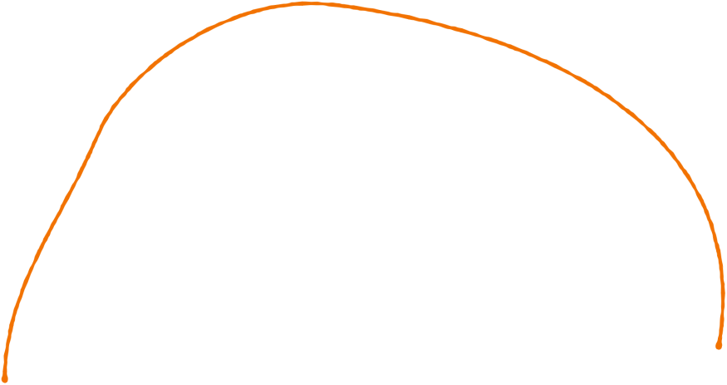
fitting
degree 2
Notes:
In this next training step, we can see the model is adapting its original line to more closely match the data.
(click) Its degree is probably 2 and it looks somewhat like a para bola.

Slide 8
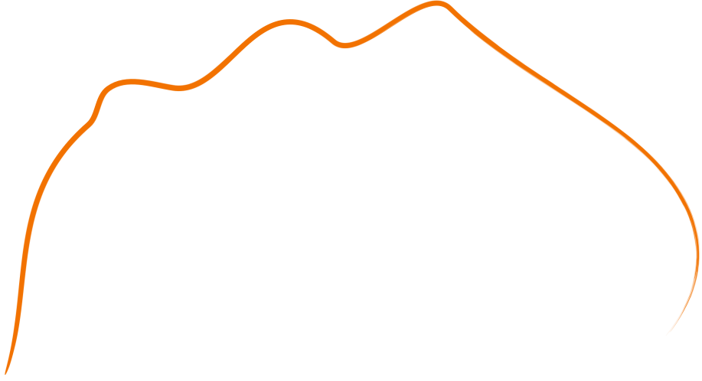
overfitting
degree 6
Notes:
With more degrees, the line gets even more complex, this is roughly what a line of degree 6 looks like.

Slide 9
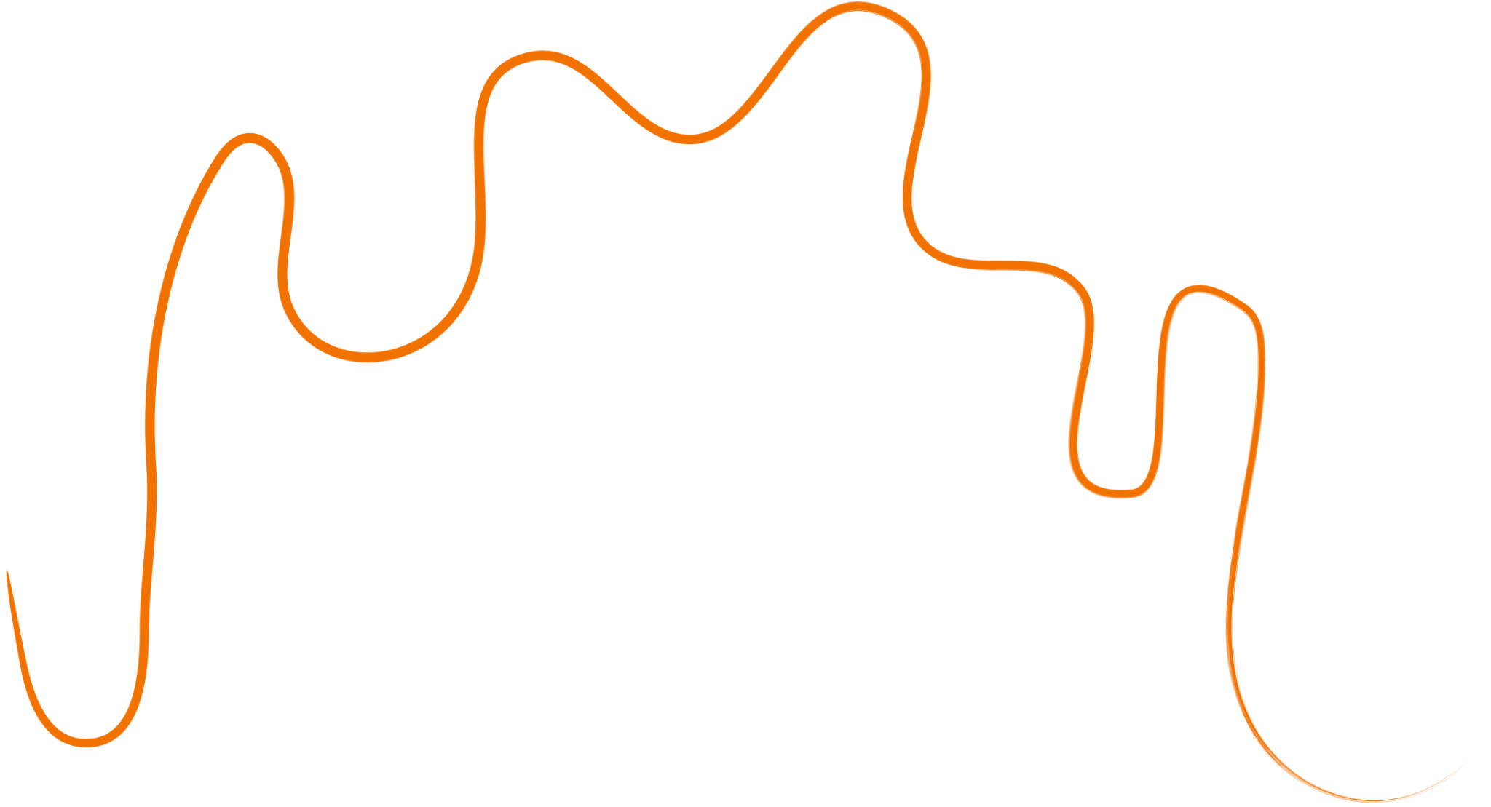
overfitting
degree 10
that’s overfit!
Notes:
Ok, we should stop here. (click), now it’s completely overfitting the data.
But just how bad is it? If you think back to the first few slides, we talked a bit about measuring the quality of a model. We can do this in a couple ways
First, let’s add some data points it hasn’t seen before.

Slide 10
overfitting
Notes:
You can visually see how the line doesn’t really match up with the new data points, so we can confidently say that this model is bad.
The line here has completely memorized the training data it was training on, and it compensated too much for every data point. The result, is that there are a lot of cases where this model does very poorly because it was simply too complex for the task.
But how do we select the correct degree then? To explain, let’s first take a look at the other lines compared to the new points we just added.

Slide 11

underfitting
still not good
Notes:
This first line is still (click) not good, even with the other data points shown.

Slide 12
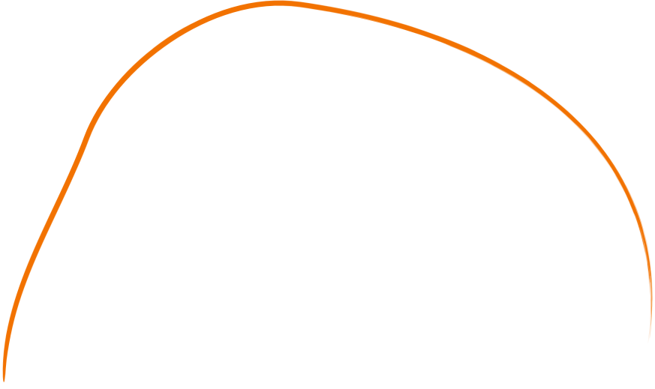
overfitting
Notes:
However, the second line is a lot better. It more closely follows the training points in black compared to the 1st line but not as much as the 4th one. In the case of this dataset, it also approximates the underlying pattern of the testing data very well
In this example, this curve with a degree of two would be perfect.
Lets see a side by side comparison of all the lines our model has predicted

Slide 13
overfitting
Notes:
HOLD! for transition

Slide 14


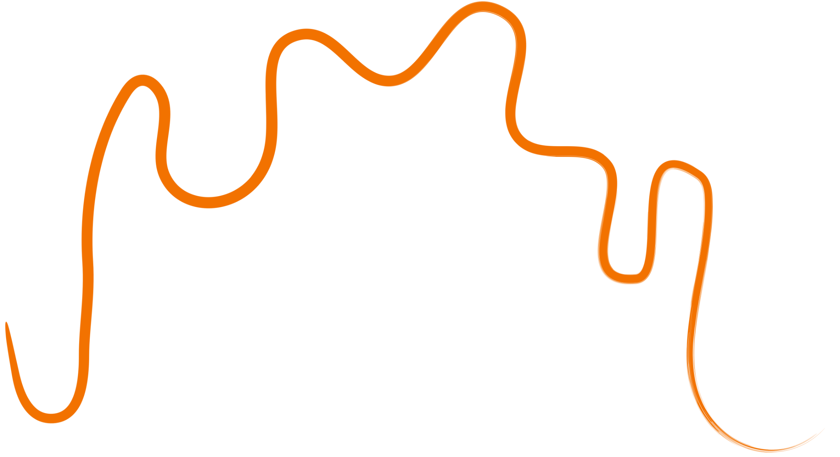
overfitting
degree
1
2
6
10
overfitting frequently takes place when the degree of a regression model is set too high
Notes:
In general, higher degrees makes the model more and more closely memorize the training data, but smaller degrees make the model bad at predicting. When you design your model, the degree you want is a parameter that you must choose carefully. (click)
If your data follows a predictable property, such as a projectile moving through the air, then you could choose a degree based on background knowledge that a projectile moves in a parabolic path.
But for data that’s more difficult to grasp, such as wine acidity, it’s usually best to just try a couple and see which ones work best.
TAKE QUESTIONS ABOUT OVERFITTING

Slide 15
What would overfitting look like in classifications?
Notes:
We used a regression example to illustrate the idea of over fitting. What about classification problems? Do we also have overfitting or underfitting? What would they look like. Consider decision tree. Can you overfit?

Slide 16
How do we address under/overfitting?
Notes:
Let’s talk about some other ways we can address overfitting.

Slide 17
address overfitting
training data
Notes:
An easy way to address overfitting has to do with our data. As you can see here, this big rectangle represents all of our training data

Slide 18
address overfitting
validation data
training data
test data
Notes:
We use a portion of our training data and we repurpose it for validation and testing - here you can see the two new rectangles were separated from the training data and renamed

Slide 19

address overfitting
Model Hasn’t Seen
Model Has Seen
validation data
training data
test data
we use validation and test sets, small subsets of data the model hasn’t seen before,
val point(s)!
Notes:
This is an important concept because the model frequently sees and learns using the training data, (click)
But it must not be able to see the validation or testing data. This way, we can accurately get a representation of the model’s actual accuracy on examples it HASN’T seen before and adjust model parameters as needed from there. (click)
If you think back to the red and green lines, that extra point we plotted is a validation point. During the actual validation process however, there's a lot more data points plotted instead of just one.

Slide 20


address overfitting
Model Hasn’t Seen
Model Has Seen
validation data
training data
wait but what’s the difference?
test data
Notes:
But what’s the difference between the validation and testing data then?
The example with the red and green lines with the new datapoint is an example of how you would use validation data. It tells you when your model is overfitting and how you should adjust parameters while training.
But testing data, (click)

Slide 21
address overfitting
Whole Dataset
standardized for benchmarking!
test data
test sets are, unlike validation sets, usually set by the data creator as common, unseen benchmark data.
Notes:
Testing data is a small section of your whole dataset. You only deal with testing data once you are 100% done with your model. The purpose of testing data is for benchmarking: (click)
this is important to compare different models’ performance. The test set will always be consistent for the same dataset, usually, its even supplied separately to avoid confusion. (click)
When you want to test multiple models’ performance on a dataset, using a common set of benchmark data ensures that any improvements in accuracy are from the model improving and not just a difference in the testing material.
so now that we have talked about the different categories of data lets answer our initial question on how we can address underfitting/overfitting- the way we can address overfitting and underfitting when we have more complex data is to simply set data aside so you can test your model, that way you can see if increasing the degree of your regression model is really improving the accuracy or not

Slide 22
overfitting can be dangerous
data ethics
Notes:
Ok, so why do we care about overfitting so much? this falls under the category of data ethics so when we are implementing our models into real life applications we want to make sure that it will be accurate on inputs that it hasn't seen before

Slide 23
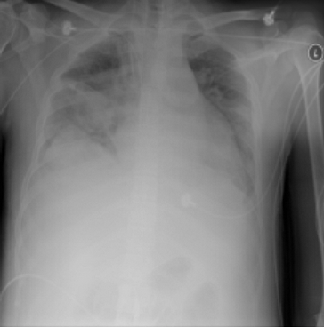
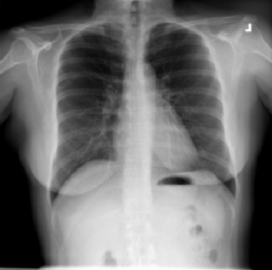
data ethics
which one has pneumonia?
Notes:
In this example, a model was trained to detect pneumonia in patients xrays. (click) (click)
In this case, the person on the left is the one who has pneumonia. However, the model decided with 90% certainty that it was the person on the right.
If we highlight the area that the model focused on the most, (click)…

Slide 24


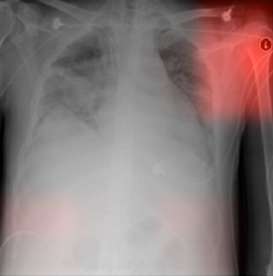
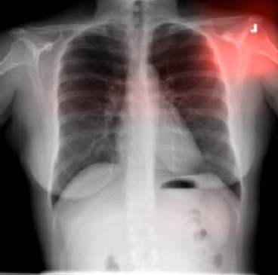
data ethics
different hospitals used different markers!
models, when not controlled for external factors, often overfit on easy targets
Notes:
you can see that it was really focused on the top right, the shoulder.
So as a bit of context, the hospital that provided the pneumonia data for this model had a specific marker that it placed on all their xrays, and the hospital that provided the non-pneumonia data used a different marker. (click) (click)
So why did the model feel so certain about its prediction, the model started overfitting to that one marker, because when it was training, whenever it saw that marker it would immediately mean that the patient had pneumonia. When a different one showed up, it would immediately mean that the patient didn’t have pneumonia.
This is a great example of overfitting because the model does poorly when introduced to data it has never seen before
As you can see, overfitting can have consequences because diagnosing a patient incorrectly can be extremely dangerous
Before i move on does anyone have any questions TAKE QUESTIONS

Slide 25
Feature selection & Feature engineering
Notes:
Ok, so to move on from overfitting, let me introduce a new idea, feature selection and feature engineering

Slide 26
Motivation
Feature Selection
Performance could degrade when including input variables that are not relevant to the target variable.
Overfitting for tasks with a smaller # of samples
A large number of variables can be computationally expensive
Notes:
what are features? - features are the inputs of a model
for example if you were working with a data set on houses, examples of inputs could be the # of rooms the house has or what the square footage is
the whole idea around feature selection is to choose features that will improve the accuracy of the model and to remove features that are not relevant - often times when you're dealing with your own projects the data set that you find will not always be perfect and many of the features that the data set includes will not always be useful for your specific goal
so why does removing irrelevant features matter?
well, having a lot of features can just be computually expensive - what i mean by this is that if you're trying to test different parameters for example if you were trying to find the best degree for your model and you have so many features that cause the run time to be so high, it's not going to be time efficient

Slide 27
Typical techniques
Feature Selection
Remove features with low variance (e.g., zero variance)
Remove features with low correlation based on statistical tests
Sequential feature selection
Forward: iteratively add the best new features
Backward: iteratively remove the least useful feature
https://scikit-learn.org/stable/modules/feature_selection.html
Notes:
so what are the typical techniques? again, the idea of feature selection is to remove features
these features can be those that have low variance, in other words, you want to remove features that have little impact on the accuracy of the model
you also want to remove features with low correlation because you know it won't affect the model's accuracy if the feature is not related
Forward Sequential Feature Selection:
In forward sequential feature selection, the process begins with an empty set of features. It incrementally adds one feature at a time to the set, evaluating the model's performance after each addition. The feature that, when added, provides the most improvement in model performance is selected. This process continues until a predetermined stopping criteria is met, such as reaching a specific number of features or achieving a certain level of model performance.
Backward Sequential Feature Selection:
Backward sequential feature selection starts with all available features and removes one feature at a time. The feature to remove is selected based on its impact on the model's performance, with the goal of removing the feature that has the least impact. This process continues until a stopping criteria is met.

Slide 28
Feature Engineering
Feature Selection
Different from feature selection
Example: predict time-to-sell of a house
Input (features and label): square footage, lot size, transaction date, built date, and price
Engineered features could include
Cost per sq. ft
House age
Zip code
School rating
Data preprocessing (e.g., normalization, missing data) sometimes are also considered as feature engineering
Notes:
Feature engineering is the process of creating new features or modifying existing features from the raw data
this is done to improve the performance of a machine learning model.
It involves selecting, transforming, or generating specific features that are more informative, relevant, or representative of the underlying patterns in the data.
Feature engineering plays a crucial role in enhancing a model's ability to learn and make accurate predictions.
going back to my example with houses, engineered features could include the following - cost per sq. ft, house age, or zip code
Additionally, feature engineering could also be data preprocessing, such as normalization, or fixing missing data - often times in a data set you might encounter a lot of Na values and since learning algorithms cannot compute these values you'll manually fix it - this is essentially the idea of feature engineering

Slide 29
Typical process
Feature Selection
Brainstorming features
Deciding what features to create
Creating features
Testing the impact of the identified features on the task
Improving your features if needed
Repeat
Notes:
the universal process that people typically follow if you were to implement this strategy on your own, starts with brainstorming - you want to really stop and think about what variables will affect the accuracy of your model
after you brainstorm, you want to decide which features to include or create
then you want to test the impact of the new features.
Does anyone know which set of data you’d use to test? validation data
this is to see if the new features are really helping to improve the accuracy
after testing, you repeat this process to create as accurate of a model as possible

Slide 30
Features
Feature Selection
Feature selection
Feature engineering
PCA
Differences
Notes:
table of contents

Slide 31
Improving Outcome
Notes:
so let's talk about improving outcome, or, in other words, improving accuracy

Slide 32
Debugging a learning algorithm
Improving Outcome
A dataset
Applied a machine learning algorithm
Got a result, e.g., error rate 11%
Is this a good result?
Credit: Advanced Machine learning, Andrew Ng, Coursera, for the debugging discussion .
Notes:
improving accuracy can come in the form of debugging a learning algorithm
let's say you start with having the data set and having applied a machine learning algorithm and get an error rate of 11%, would you consider this a good result? well maybe if you were gambling - 11% could be good odds, but if you were diagnosing a patient for a certain disease, 11% might be too high

Slide 33
Establish a baseline
Improving Outcome
What is a reasonable level of error we can hope for?
Human level performance
Competing/existing algorithms
Educated guess based on experience
Notes:
to establish a baseline, we want to ask “what is a reasonable level of error”
well you want to consider human level performance or how well a human could guess - because usually your model should be as good or better than a human at predicting
you also want to consider competing or other existing algorithms because obviously the goal is to create more accurate models than before
And similar to human level performance you want to compare the models accuracy to educated guesses - this is just to test different ways we can compare the models accuracy

Slide 34
Bias/variance
Improving Outcome
 | Case 1 | Case 2 | Case 3
Baseline (e.g., human) | 10.6% | 10.6% | 10.6%
Training error | 11% | 15.5% | 11%
Validation error | 16% | 16% | 12%
Notes:
so lets look at a table real quick. we have 3 different cases which had some form of change in between each one - like changing parameters or features
and then we have our baseline error rate with a human
error rate on the training data
and error rate on validation data
as you can see baseline data doesn't change but we can see its 10.6
the training error started at 11 then went to 15 and then back to 11 when the person realized that the change they made did not improve the accuracy
and then as you can see the model was able to do decently well on the validation data with a 12% error rate which is still worse than a human
but how are we getting different errors for validation and training data

Slide 35
Debugging
Improving Outcome
Bias: error from erroneous assumptions in the learning algorithm - represents model’s tendency to underpredict or overpredict
Variance: error from sensitivity to small fluctuations in the training set - represents how much a model will be affected by small changes in the data
Notes:
well lets look at these two new terms
Bias:
Definition: Bias refers to the error introduced from using a overly simplified model. Bias represents the model's tendency to underpredict or overpredict the true values.
so let me list some characteristics of bias:
- High bias leads to underfitting, where the approximated line is too simple to capture the underlying patterns in the data.
- The model is overly generalized and unable to adapt to the training data, leading to poor performance on both the training and testing datasets.
- Bias can result from using an overly simplistic model, ignoring relevant features, or making strong assumptions about the data that do not hold true.
Variance on the other hand refers to the error introduced by the model's sensitivity to small fluctuations in the training data. It represents the model's ability to fit random noise in the training data. Essentially variance measures how much a model changes if you add outliers
again lets list some characteristics:
High variance typically leads to overfitting, where the model is overly complex and closely fits the training data but fails to generalize to new, unseen data.
The model is overly sensitive to the training data's idiosyncrasies, making it perform well on the training dataset but poorly on the testing dataset.
Variance can result from using a very complex model or not having enough data to support the complexity of the model.

Slide 36
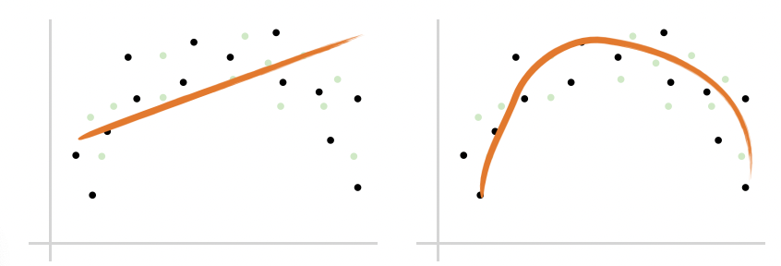
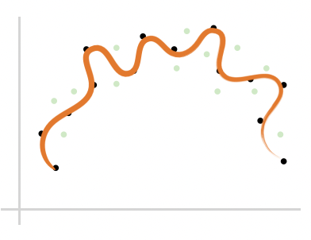
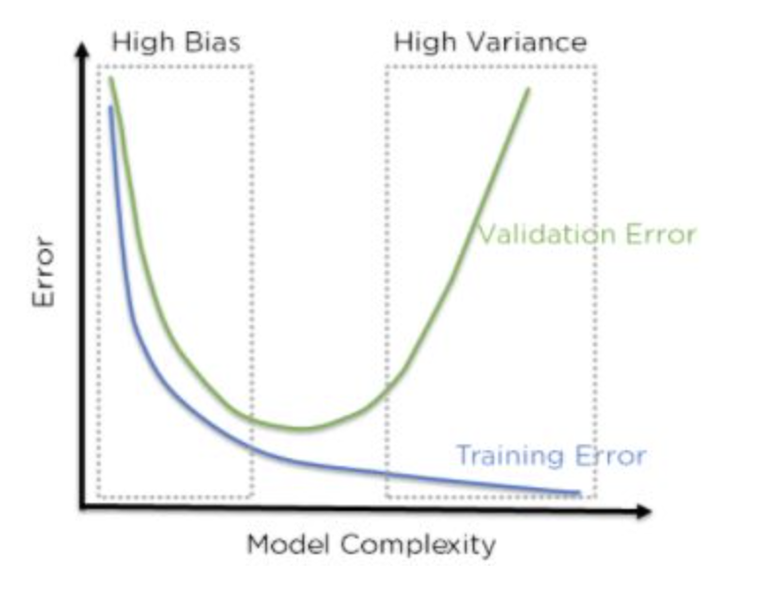
Debugging
Improving Outcome
High bias: training error high
High variance: validation error high
Notes:
The bias error is an error from erroneous assumptions in the learning algorithm. High bias can cause an algorithm to miss the relevant relations between features and target outputs (underfitting).
The variance is an error from sensitivity to small fluctuations in the training set. High variance may result from an algorithm modeling the random noise in the training data (overfitting).

Slide 37
Debugging
Improving Outcome
High bias: training error high
High variance: validation error high
What can we do?
Notes:
so what can we do to address this?

Slide 38
Debugging
Improving Outcome
High bias: training error high
High variance: validation error high
Try getting additional features
Try adding polynomial features
Try decreasing regularization or use larger models
Get more training samples
Try smaller set of features
Try increasing regularization or use smaller models
Notes:
some things we can do include, trying to get additional features or adding polynomial features
we could also try decreasing regularization or use larger models
Similarly, we can get more training samples or try a smaller set of features

Slide 39
Debugging
Improving Outcome
Try getting additional features (high bias)
Try adding polynomial features (high bias)
Try decreasing regularization or use larger models (high bias)
Get more training samples (high variance)
Try smaller set of features (high variance)
Try increasing regularization or use smaller models (high variance)
Notes:
so let’s address a few ways we can improve our overall accuracy
one way we can fix high bias is if we get additional features
adding polynomial features can also fix high bias
decreasing regularization also means adding a penalty for having higher cost which can fix high bias
to fix high variance we can get more training samples, try small set of features, or increasing regualrization

Slide 40
Error analysis
Improving Outcome
Examine where the model went wrong
Categorize the errors
Focus on how to fix these errors (or most of them)
Notes:
another way we can improve outcome is to conduct error analysis - this comes in the form of categorizing errors and examining where the model could have potentially gone wrong

Slide 41
Example
Improving Outcome
Food spoilage prediction
Manually examine 100 examples where our model got wrong
Categorize them based on common traits
Southern CA: 21
Valley: 10
Raining weather: 50
Packaging: 5
More data and features for SoCal and raining days
Notes:
For example, if you were working on a project for a food spoilage prediction model and your model is not as accurate as you would like, you’d start by examining 100 examples of where the model gave an incorrect prediction and label these examples. After going through all 100 examples, you want to categorize these examples to pinpoint trends that you can address
To model what this would look like, we have some labels that we made up as we identified examples of the model being incorrect. As you can see, the model tends to struggle with examples that are related to raining weather and Southern California. To improve the accuracy you would want go through the feature engineering process to see what features are hindering the accuracy of the model in these categories.

Slide 42
A Real Example
Improving Outcome
Gait analysis to classify stroke patient in recovery vs. control
Notes:
Where we looked at what we got wrong and realized that those patients are the ones with other pathologies

Slide 43
When to Use Which Algorithm?
Improving Outcome
Start simple
Try the typical ones
Sklearn guideline
Notes:
Another way to improve accuracy is to choose the best learning algorithm.
A way to do this is to start simple and use traditional learning algorithms such as supervised learning algorithms
a good recourse is to look at sklearn guidelines

Slide 44
Potential Pitfalls
Notes:
So, I also want to address potential pitfalls

Slide 45
Things that can go wrong
Potential Pitfalls
Inconsistent preprocessing
Data leakage
Model is used on test data that has changed
Selecting appropriate metrics
Hidden confounders
Spurious correlations
Performance on subgroups may be missing
Data biases
Notes:
https://towardsdatascience.com/machine-learning-pitfalls-e54ac3edc25

Slide 46
Things that can go wrong
Potential Pitfalls
Inconsistent preprocessing (e.g., different scaling/normalization)
Data leakage (e.g., temporal or mixing subjects)
Model is used on test data that has changed
Selecting appropriate metrics (e.g., is 99% accuracy good enough?)
Hidden confounders (e.g., golf is correlated with heart attacks)
Spurious correlations (e.g., hospital ID on images)
Performance on subgroups may be missing
Data biases (e.g., AI recruiter)
Notes:
https://towardsdatascience.com/machine-learning-pitfalls-e54ac3edc25

Slide 47
ML Examples

Slide 48
Be Cautious
ML Practices
AI/ML is not a cure-all
“All models are wrong, some are useful.” –George Box
Understand your models, know the assumptions and limitations of the models
Is AI a hype or a GE?
Notes:
- If I flip a coin. Can you predict which side will be on top? No in general sense. Yes, if you can model everything that affect coin flip.
- Example: early AD prediction. Using EHR(I have to keep telling not going to be very good). Use Neuropsychological assessment.
Be aware of hypes. However, also recognize the power of ML. To me, knowing the basics of ML is a big enabler.

Slide 49
Typical steps to apply ML
ML Practices
Data preprocessing
Trying different ML algorithms
Training set, validation set, test set
Diagnostics
More training samples
Increase/decrease feature set
Increase/decrease regularization
Loop back

Slide 50
A ML Project
ML Practices
Why ML is a suitable approach
Do not use ML for the purpose of using ML
Evaluate existing approaches and room for improvement
Problem abstraction and formulation
Set appropriate goals
Model complexity, data availability, evaluation
Domain knowledge critical
Data collection and data cleaning
What, where, and how
ML algorithms
This is often the “easy” part
Evaluation, sanity check, interpretation
Iterate the process
Notes:
Problem abstraction and formulation can be important. In networks, the number of states can be extremely large if not carefully managed. This is a place where domain knowledge can be important. What are the important features, what are independent, what is the time granularity?
Consider the cellular QoE example (call complain). There are many different ways we could potentially formulate the problem: prediction-model + optimization, bandit algorithms, RL, deep RL. Data availability is a key factor. Learning complexity is another.
Set appropriate goals: ex: "Many studies applying machine learning to viticulture aim to optimize grape yields, but winemakers “want the right levels of sugar and acid, not just lots of big watery berries”.”

Slide 51
Characteristics of Good Problems
ML Practices
Existing solutions not satisfactory
Automate the process
Improve performance
Data availability: suitable data available or obtainable
Data quality and quantity
Can evaluate proposed approaches
Large complex problem beyond white-box modeling
Understanding complex venue and large data

Slide 52
Project Examples
Sanitation classification
Tomato processing loss prediction
Dietary recommendation
Help breeders to run more efficient and targeted breeding programs
Gait analysis
Biomarker identification
Disease outbreak prediction
Weather – outbreak spatial temporal analysis
Network traffic scheduling
Encrypted traffic classification
Traveling salesman

